Slide 1
Weekly Project Update
Abdellah Sabhi
Laurent Bialylew

Slide 2
Work done this week
01
02
03
04
Created UMLs
Created a README file
Added new UMLs
Added a README file to our github repository
Added new models
Added new functions
Created the book and author models
Created the add_books, add_authors, get_authors, search_books, and sort_inventory functions

Slide 3
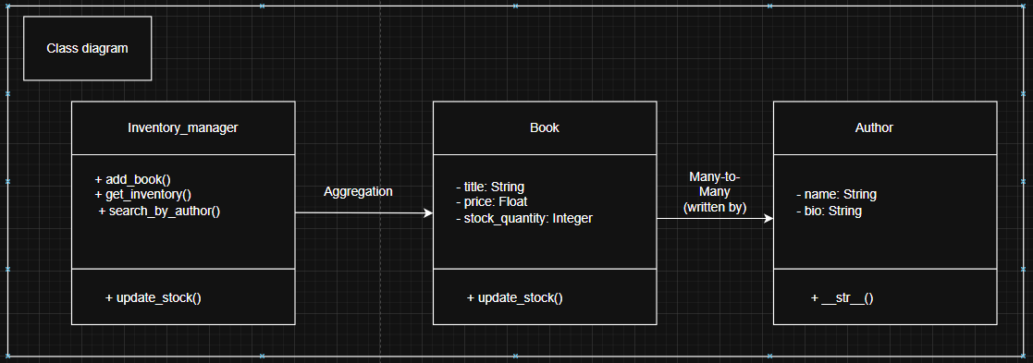
Class UML

Slide 4
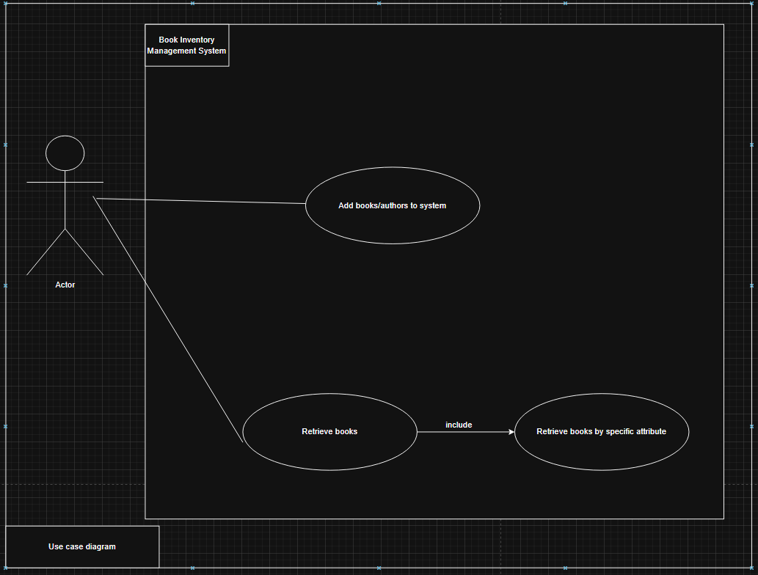
Use case UML

Slide 5
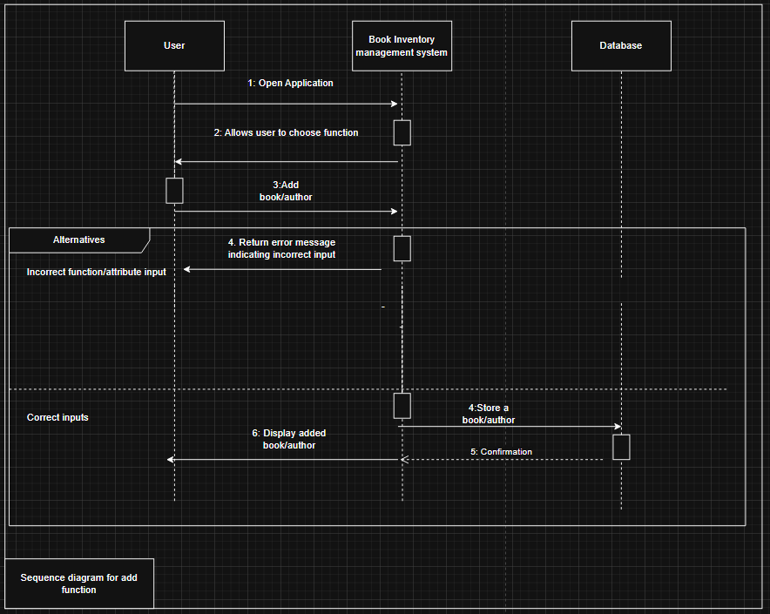
Sequence UML for add function

Slide 6
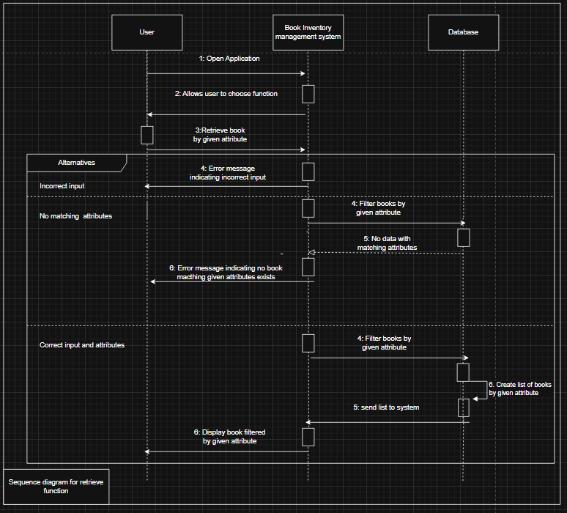
Sequence UML for retrieve function

